Slide 1

Sprocket Central Pty Ltd
Data analytics approach
By: Sohaib Muhammad Khan

Slide 2
Agenda
Introduction
Data Exploration
Model Development
Interpretation

Slide 3
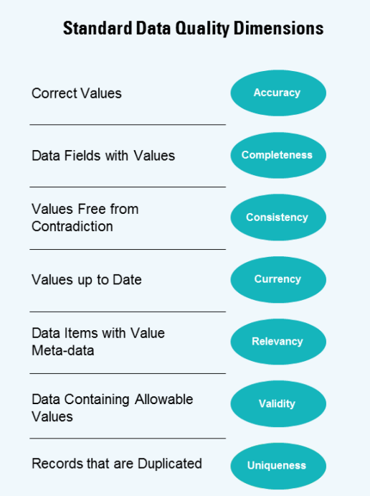
Introduction
Data Insights:
Sprocket Central Pty Ltd , a medium size bikes & cycling accessories organization, has approached Tony Smith (Partner) in KPMG’s Lighthouse & Innovation Team. Sprocket Central Pty Ltd is keen to learn more about KPMG’s expertise in its Analytics, Information & Modelling team.
Smith discusses KPMG’s expertise in this space. In particular, he speaks about how the team can effectively analyze the datasets to help Sprocket Central Pty Ltd grow its business.
Primarily, Sprocket Central Pty Ltd needs help with its customer and transactions data. The organization has a large dataset relating to its customers, but their team is unsure how to effectively analyse it to help optimize its marketing strategy.

Slide 4
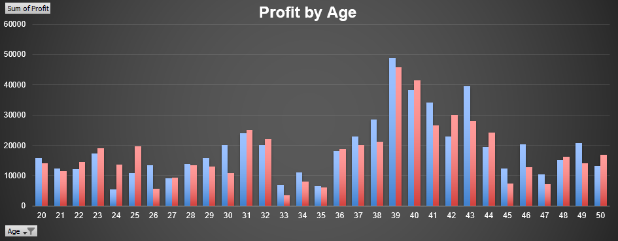
Data Exploration
Profit by Age: Analysis
By looking at the Bar Chart we can see that the Profit between age 38 – 44 out of 50 is the peak profit ages for both Males and Females as compared to other ages.

Slide 5
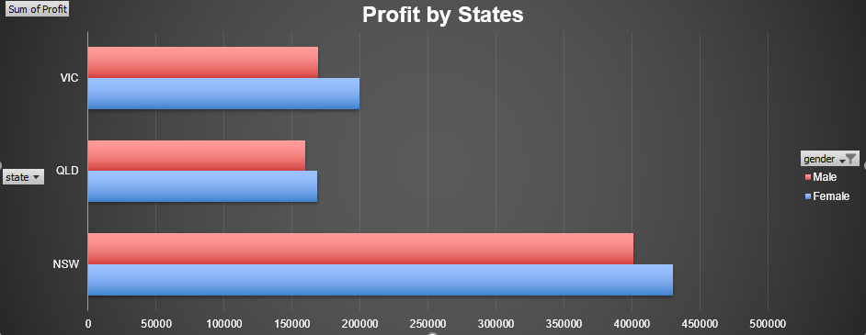
Data Exploration
Profit by States: Analysis
By looking at the Bar Chart we can see that the Profit of both Gender of New South Wales is more as compared to other States.

Slide 6
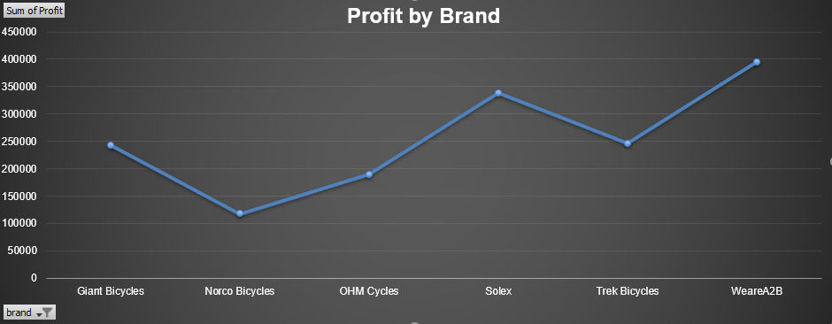
Data Exploration
Profit by Brand: Analysis
By analyzing the Bar Chart we can see that the Profit of WeareA2B is more as compared to other Brands.

Slide 7
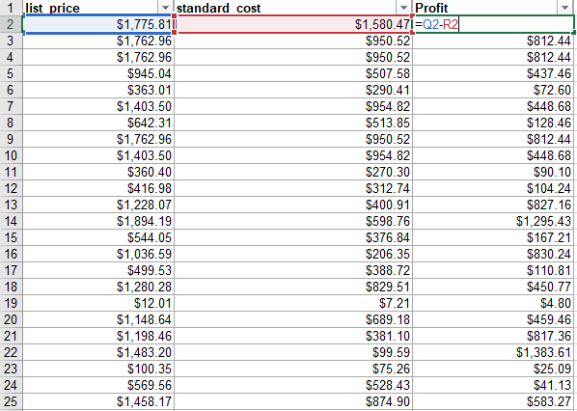
Model Development
Data Transformations and Modeling
To find the profit, we need to calculate the profit.
We can calculate profit by subtracting list_price from standard_cost from Transaction table.

Slide 8
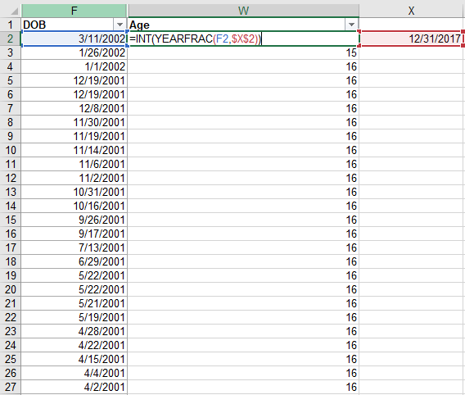
Model Development
Data Transformations and Modeling
The DOB of the customers has to be changed into their Age to find profit as ages per the transaction year.
The =INT(YEARFRAC(startDate,TransactionDate)) function has used to change into the age.

Slide 9
Interpretation
Insights:
By the above analysis we can see that the males and females of above 40’s are more likely the reason for more profit
In the state ‘NSW’ and the product that gives the most profit out of all the brands is “WeareA2B”.
By making the most profit giving product more better, we can increase our sales and profit.

